Slide 1
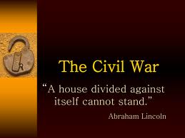

Slide 2
Names for the War - song
The Civil War
The War of Northern Aggression (South's name)
War Between the States
War of Rebellion
War of Southern Independence
Freedom War
War of Secession

Slide 3
Causes of the Civil War
While watching the short video list on your index card the reasons why the war began.
video

Slide 4
Let’s make our folder!
1. Color cover sheet and glue on front.
2. Write name and class period on the tab.
3. Glue yellow envelope on back of folder and label Notes/Worksheets
4. Glue 5 envelopes to the inside cover (open flap facing forward).
Label:
Battles/Events
People
Vocabulary
Review
Events leading up to Civil War

Slide 5
North Vs. South – complete chart

Slide 6
Education
North
South
Many Private Schools
Public Schools
Open to both boys and girls
No formal education system
Private tutors for the upper class
Community schools with untrained teachers in rural areas

Slide 7
Slavery
North
South
Abolish Slavery
Supported Slavery

Slide 8
States Rights
North
South
Wanted strong national government
Believed states had the right to rule themselves

Slide 9
Economy
North
South
Factories, mining, banks,
stores, and railroads
Agriculture = cotton, rice tobacco

Slide 10
Tariffs
North
South
Wanted to place a tariff on imported goods so that the south would buy from them.
South was against this tariff because they said it violated their states rights.
Nullification controversy – south wanted to nullify (no longer legal) this tariff.

Slide 11
Culture
North
South
Many large cities with museums, operas, and
theaters
Few large cities – mainly rural areas

Slide 12
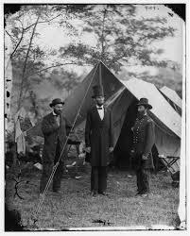
Events leading up to Civil War
Make a notecard for each of the following events that led up to the Civil War.

Slide 13
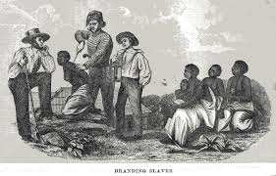
Slavery
The North was against slavery and the south wanted to allow it due to the South's economic situation.

Slide 14
Missouri Compromise
Missouri was allowed into the Union as a slave state as long as Maine could come in as a free state. This kept the number of slave states equal to that of free states.

Slide 15
Compromise of 1850
California would be a free state. (North happy)
Slavery could continue in Washington DC though slave trading ended. (South happy)
Fugitive Slave Act – Punished people who helped slaves escape and returned slaves to their owners (south happy).

Slide 16
Georgia Platform
Georgia would remain with the Union after the Compromise of 1850 as long as the North complied with the Fugitive Slave Act and would stop trying to ban slavery in new territories and states. If not, Georgia would secede!

Slide 17
Kansas-Nebraska Act
New territories Kansas and Nebraska could vote on whether they wanted to be a free or slave state.
Fighting broke out (mini civil war)

Slide 18
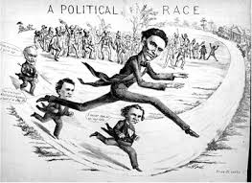
Election of 1860
Lincoln was against slavery so when he was elected the Georgia was scared and decided to secede from the Union.

Slide 19
States’ Rights and Nullification
The Southern states believed that most o fthe power should be held by the states and not the federal government.
They South wanted to “nullify” laws they believe violated states’ rights.

Slide 20
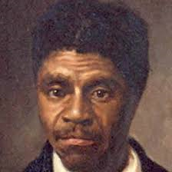
Dred Scot
Sued for his freedom when his master died.
The S.C. said he had no right to sue because he was not a citizen.
This decision made abolitionists
(people wanting to outlaw slavery)
furious!

Slide 21
Book Work
Turn to Chapter 15 pg. 47 in your workbook. Read pages 48-56 silently.
Place a box around all headings
Underline all key words (bold print, itallics)
Complete activities as you come to them in your book.
20 minutes

Slide 22
Vocabulary – write each word on a separate index card and place in the vocabulary envelope of your folder.
Naval Blockade
Blockade Runner
Eastern Theater
Western Theater
Confederacy
Siege
Secede or secession
Nullification
States’ rights
Abolition

Slide 23
Important people of the Civil War
Make a notecard for each for the following people.
Intro Video

Slide 24
Jefferson Davis
*military experience
*He was involved in the United States Government.
*graduated from West Point.
*President of the Confederacy

Slide 25
General Robert E. Lee
General of the Confederate Army of Northern Virginia in the American Civil War.
video

Slide 26
Abraham Lincoln
First elected Republican.
President of the United States
of American throughout the
Civil War.
He was assassinated a few days
after the War ended by
actor John Wilkes
Booth.

Slide 27
General Sherman
General of the Union army.
In charge of Western forces.
Invaded Georgia in 1864 – March
to the Sea
March was successful and led to
The end of the war.

Slide 28
Ulysses S. Grant
General of the Union
Army during the second
half of the Civil War.
His success led to the
Presidency of the
United States.

Slide 29
General Longstreet
Lived in Gainesville ,Georgia (Longstreet Clinic, Longstreet Café (yum!)).
Served under General Lee in the Confederate Army.
Finest commanders in the army (both North and South).
After the war was criticized for switching to the Republican Party and supporting General Grant as President.

Slide 30
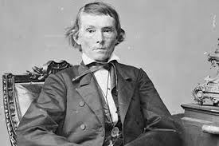
Alexander Stephens
Georgian
He tried to convince GA that
Lincoln was not the enemy and was AGAINST succession.
However, once GA seceded he agreed to become Vice President of the Confederacy.

Slide 31
Battles and Events
Write the following battles and events on notecards and place them in the corresponding envelope in your folder.

Slide 32
Where it all began – Fort Sumter, South Carolina

Slide 33
Fort Sumter – video video2
Watch video and read the section on Fort Sumter on pg. 63 of your text book. On your notecard of Fort Sumter list the following information.
Why did Lincoln contact the governor of South Carolina?
What date did the Confederacy attack?
Who won?

Slide 34
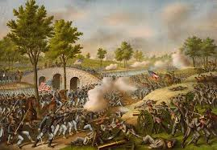
The Battle of Antietam (video)

Slide 35
Battle of Antietam Facts – Make a notecard and but in the Battles/Events envelope.
Occurred on September 17, 1862.
It was the bloodiest one day battle of the Civil War, claiming over 23,000 American lives.
General Lee wanted to bring the war to the North and persuade Maryland(slave state in the Union) to join with the CSA. This did not happen!
How did the Union Army know where to find the Confederate Army?

Slide 36
Emancipation Proclamation – Notecard
1. Battle of Antietam on September 22, 1862.
All slaves in the rebellious states would be freed on January 1, 1863. It did not free the slaves in the Union States that allowed slaves (border states)!
If the South had surrendered before January 1st, they would have been allowed to keep their slaves.
Lincoln knew they would not surrender and this document would end slavery once the war it was over.
.

Slide 37
Emancipation Proclamation
Read skit

Slide 39
The Battle of Gettysburg –video
Notecard in Battles/Events
“turning point” of the Civil War.
Gettysburg, Pennsylvania from July 1-3, 1863.
Over 50,000 soldiers were killed on that day.
Similar to Antietam, the south had been winning and wanted to bring the war North.
5. During this battle Alexander Stephens (VP of the Confederacy) tried to go to Washing to talk with Lincoln about a peace agreement. speech

Slide 40
Battle of Gettysburg
Read skit

Slide 41
The Battle of Chickamauga – video make a Battle Notecard
Chickamauga was the first battle to occur in Georgia. It was
located in the town of Chickamauga at the Tennessee/Georgia
border.
3.The battle lasted for three days with over 34,000 causalities!
it was the largest battle fought in Georgia.
The Union Army wanted Chattanooga for its railroads.

Slide 42
Chickamauga Cont.
Significant for two reasons
It was the largest Union defeat in the Western theater of the Civil War.
2. After winning at Chickamauga the CSA tried to recapture Chattanooga and failed.

Slide 44
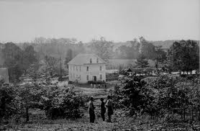

Slide 45
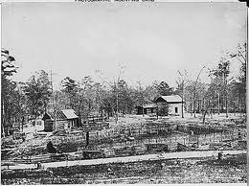

Slide 46
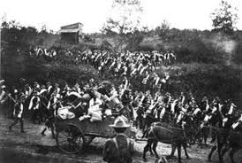

Slide 47
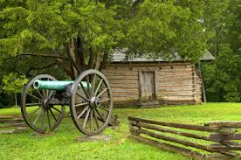

Slide 48
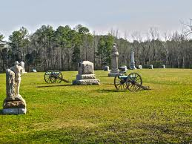
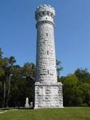

Slide 49
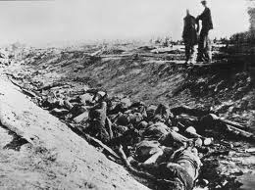

Slide 50
The Union Blockade of Georgia’s Coast
The North would use its Navy to prevent the South from shipping its cotton to England and France in return for weapons and other supplies.
General Winfield Scott was the mastermind behind this plan and he called it the “Anaconda Plan” because the intention was the “squeeze” the Confederacy to death.

Slide 52
Sherman’s Atlanta Campaign - video
spring of 1864.
Sherman wanted Atlanta
because it was a major railroad hub and its capture would
cripple the Confederacy.
Johnson’s plan was to “lure” Sherman’s army toward them
but Sherman merely “outflanked” or “went around”
Them.
In the Atlanta Campaign the South only experience
victory at the Battle of Kennesaw mountain.

Slide 53
Atlanta Campaign Cont.
Not one battle but many small battles: The Battle Of Peachtree Creek (July 20, 1864), and the Battle of Atlanta (July 22, 1864), and the Battle of Ezra Church (July 24, 1864).
Sherman occupied Atlanta for 3 months planning his “March to the Sea”.
This victory boosted the north and Lincoln won his reelection.

Slide 54
Confederate works near Atlanta, GA.

Slide 55
Destruction of General Hood’s ordinance train
In Georgia.

Slide 56
Engine "Hero" destroyed by Confederates in evacuating Atlanta, Ga. Engine used by Mitchell's men in attempt to burn R.R. bridges. They were caught upon it and hanged in Atlanta., ca. 1860 - ca. 1865

Slide 57
Fortifications near Atlanta.

Slide 58
Fortifications near Atlanta.

Slide 59
Ruins of Atlanta after Sherman’s attack.

Slide 60
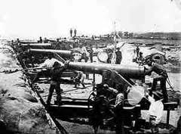
Pictures of Atlanta.

Slide 61
Sherman’s March to the Sea – video
Wanting to end the war quickly Sherman began his
“March to the Sea”.
It began on November 15, 1864 and ended on December
21, 1864 with Sherman's capture of Savannah.
The Union army created a path of destruction that
was 300 miles long and 60 miles wide.
Sherman set out to destroy factories, buildings, and
entire towns.
Savannah did not want to experience what happened in
Atlanta and surrendered.

Slide 62
Map of Sherman’s “March to the Sea”

Slide 63
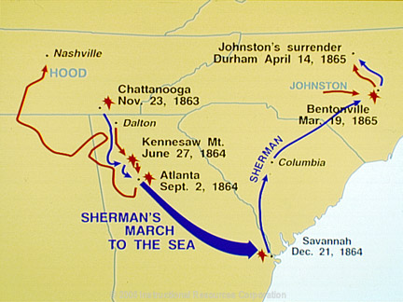

Slide 64
Surrender and Aftermath
The war ended on April 9th, 1865 when General Robert E. Lee surrendered to Ulysses S. Grant at Appomattox Courthouse in Virginia.
Two weeks later General Joseph Johnston surrender to General Sherman in North Carolina.
The war lasted 4 years and 25,000 of the 125,000 Georgians died and much of Georgia was left in ruins.

Slide 65
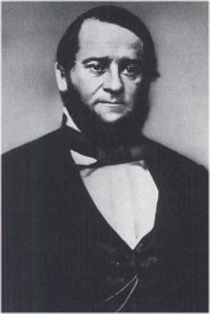
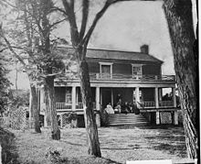
Surrender
Wilmer McLean – the war began in my front yard and ended in my front parlor.

Slide 66
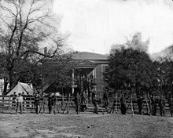
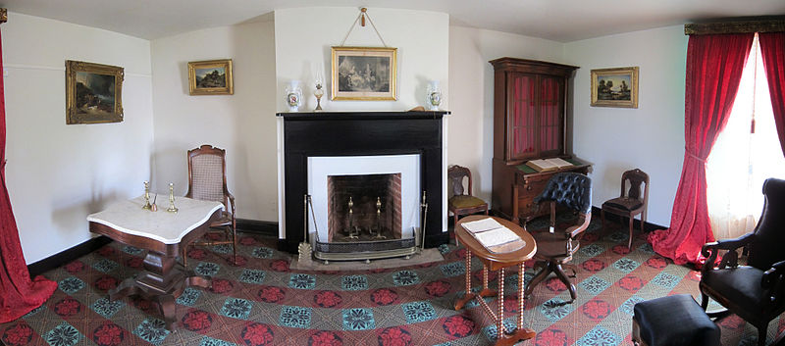

Slide 67
Andersonville - video
One of the worst prisoner of war camps from the Civil War.
Located in Macon Country, Georgia.
It was built to hold only 10,000 Union prisoners of war but help over 30,000 at the peak of its occupancy.
Water was contaminated and many men died from diseases, poor nutrition, and exposure to the elements.
After the war Captain henry Wirz, the commander of the camp, was executed by the North for war crimes.

Slide 68
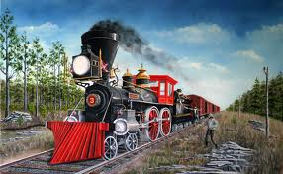
Great Locomotive Chase
Watch video clip and write a summary on the back of your notecard.
Video

Slide 69
Stone Mountain – Confederate Memorial – laser show
Jefferson Davis, Robert E. Lee, Stonewall Jackson

Slide 70
Book Work
Read pages 57-61 of your workbook.
As you read put a box around the section headings and underline key terms (bold or italics)
Highlight answers to the questions in the activities.
15 minutes

Slide 71
Civil War Times
With a partner complete you will step back in time and publish one edition of the Civil War Times.
Follow the template provided.
Double, triple, quadruple check your spelling and grammar!!!!!!!
Template – located in Coffey folder.

Slide 72
Quiz Questions
1. What was the purpose of the Union’s blockade?
A. To destroy rail lines
B. To keep the South from trading goods by ship.
C. To force Lee’s surrender at Gettysburg
D. To take Atlanta

Slide 73
2. What did the Emancipation Proclamation do?
A. It freed all slaves in the United States.
B. It put Ulysses S. Grant in charge of all Union forces.
C. It allowed slaves to fight in the Confederate army.
D. It freed the slaves in the Confederate states.

Slide 74
Why was the plan to blockade southern ports called the “Anaconda Plan?”
A. It was designed to strike fast, like a snake.
B. It involved the Union army sneaking up on the Confederacy unnoticed.
C. It was designed to squeeze the life out of the Confederacy by cutting off supplies and trade.
D. “Anaconda” was the last name of the admiral who though of the plan.

Slide 75
Who was William T. Sherman?
A. He was the Confederate general who tried to invade the North twice, but failed.
B. He was the Union general who finally defeated Robert E. Lee and forced him to surrender.
C. He was the appointed governor of Georgia during Reconstruction.
D. He was the Union general who conquered Atlanta and marched all the way to Savannah.

Slide 76
Which of the following statements BEST described the effects of the Civil War on Georgia?
A. Thousands of Georgians died fighting in the war, while many others suffered at home.
B. Other than soldiers dying in faraway battles, people in Georgia never really felt the effects of the war.
C. The war led to whites finally accepting blacks as their equals.
D. Small farmers suffered a great deal at the hands of the Union army, but people in Atlanta were spared any hardship.

