Slide 1
Foundations of Georgia Government

Slide 2
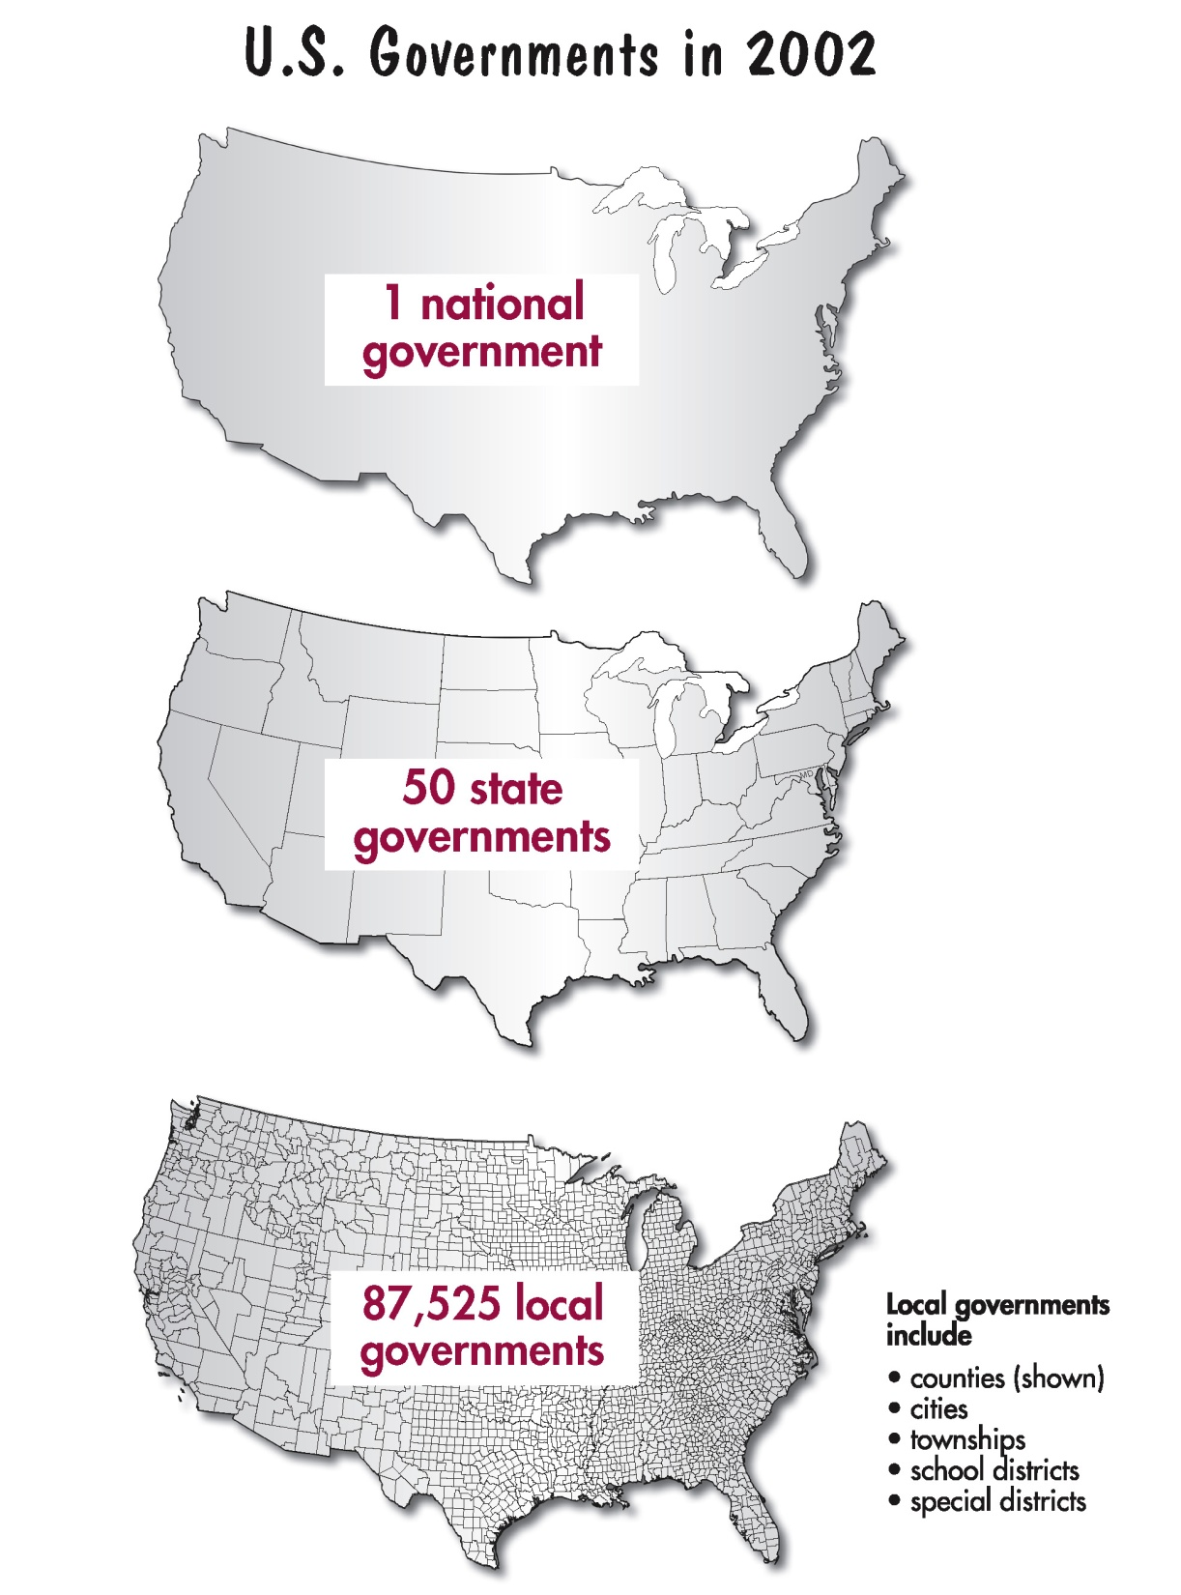
Notes:
‹#›

Slide 3
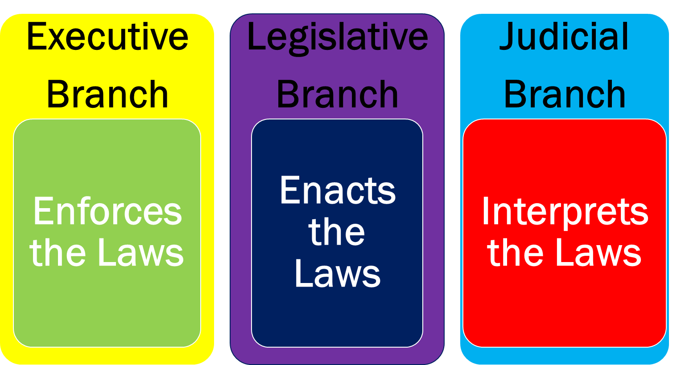
Georgia’s State Government (like our Federal Government) Has 3 Branches... (Brain Pop)
Notes:
‹#›

Slide 4
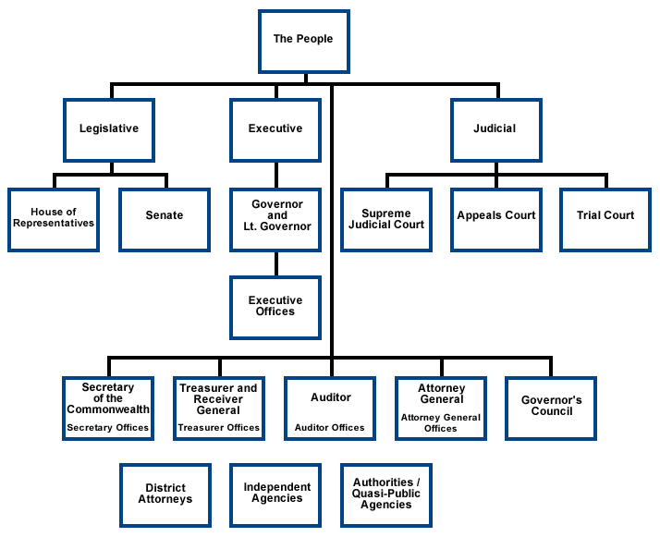
State Government
Notes:
‹#›

Slide 5
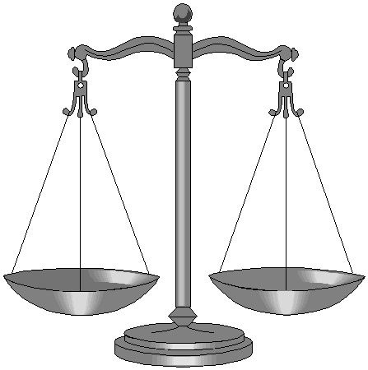
System of Checks & Balances
Notes:
‹#›

Slide 6
Separation of Powers
each branch of government has its own powers
similar to US Constitution
designed so that no branch or person can become too powerful
checks and balances system depends on citizens choosing wisely when they vote
Notes:
‹#›

Slide 7
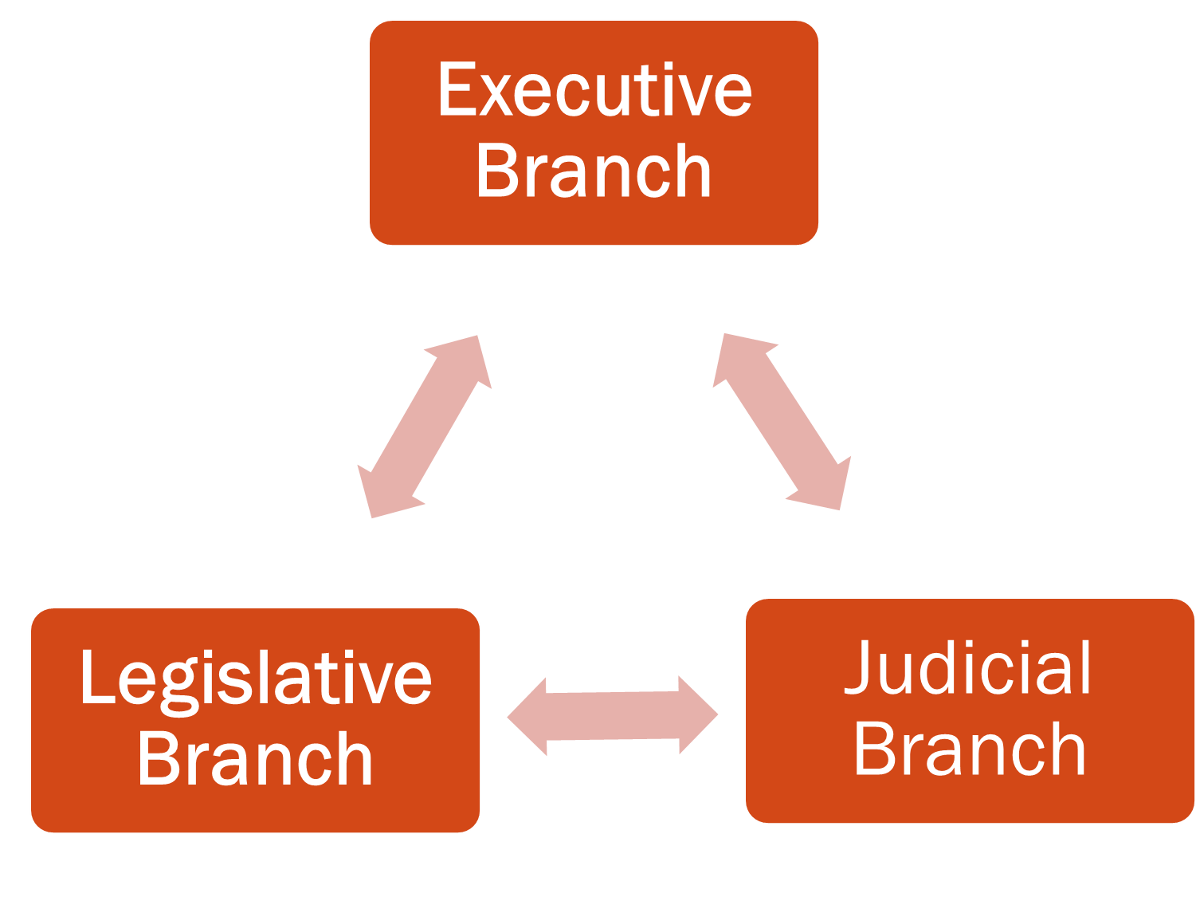
■Impeach officials in the Executive or Judicial Branches
■ Override a Governor’s veto of bills to make them into laws
Must also confirm appointments made by the Governor
Propose constitutional changes
■Veto bills passed by the legislative branch
■ Call special sessions of the legislature
■ Has some appointment powers when officers of the court resign or die
■Determines whether or not laws are constitutional
Notes:
‹#›

Slide 8
Georgia’s Government
What is the Georgia state constitution?
It is the governing document the explains the laws, governmental offices, and citizens rights and responsibilities in the state of Georgia.

Slide 9
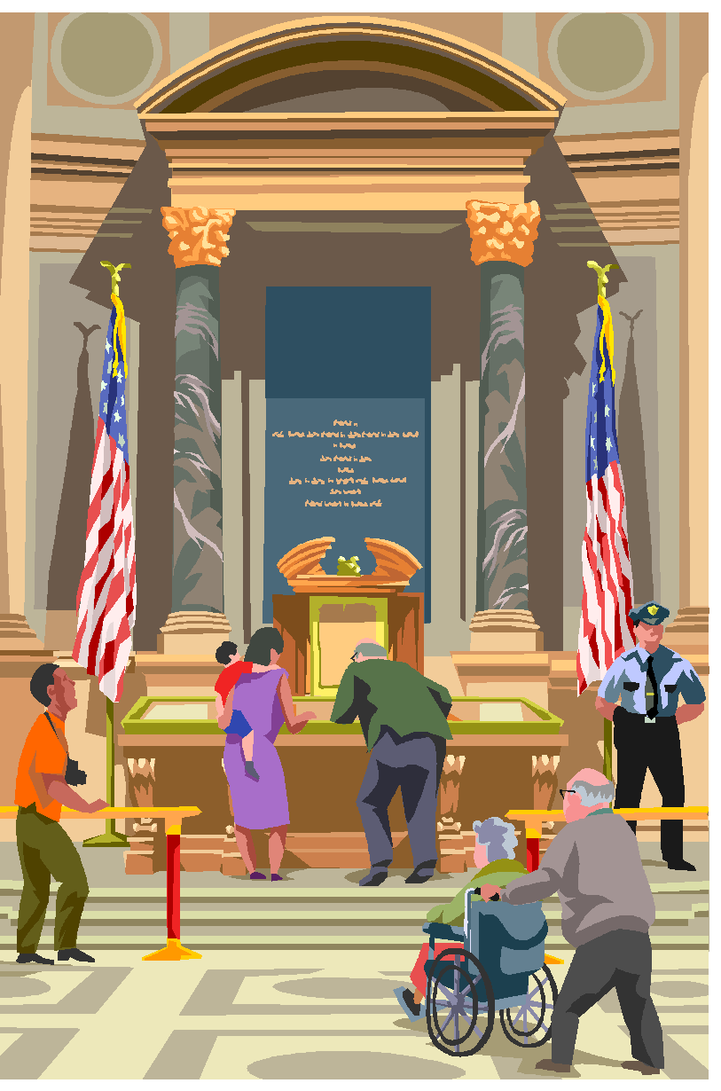
Georgia’s Government
What is the basic structure of the Georgia state constitution?
The state constitution is a living document. It is used everyday in governmental decisions.
Structure of the Georgia state constitution:
Preamble
Articles
Georgia State Constitution

Slide 10
Georgia’s Government
Article I: Bill of Rights
Article II: Voting & Elections
Article III: Legislative Branch
Article IV: Constitutional Boards & Commissions
Article V: Executive Branch
Article VI: Judicial Branch
Article VII: Taxation & Finance
Article VIII: Education
Article IX: Counties & Municipal Corporations
Article X: Amendments to the Constitution
Article XI: Miscellaneous Provisions
What is the basic structure of the Georgia state constitution?

Slide 11
Georgia’s Constitution
Georgia adopted its first state constitution in 1777.
In 1983, Georgians approved the state’s 10th Constitution.
Purpose has always been the same... It gives voters the right to control state government by electing state officials. Citizens may also suggest laws that improve the way the state is governed.
Notes:
‹#›

Slide 12
I want to Vote!
You must be a citizen of the United States.
You must be a legal resident of Georgia nd the of the county where you wish to vote.
You must be at least 18 years of age by Election Day.
A citizen cannot vote if he or she is serving a sentence for a felony conviction, or is declared mentally incompetent by a judge.

Slide 13
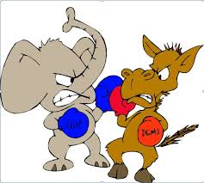
Political Parties Video
Functions of Political Parties
Recruiting and nominating candidates
Educating the electorate about campaign issues
Helping candidates win elections
Monitoring actions of officeholders

Slide 14
I Pledge Allegiance to the . . Georgia Flag
“I pledge allegiance to the Georgia flag and to the principles for which it stands: Wisdom, Justice, and Moderation.”
Wisdom – reminds Legislative branch to be wise in creating laws.
Justice – reminds the judicial branch to be fair and just in their decisions
Moderation – reminds the executive branch to carry out laws calmly within the boundaries of the law.

Slide 15
The Executive Branch (Largest Branch)
Governor is the chief executive officer of the state
Lieutenant Governor
Attorney General
Commissioner of Agriculture
Commissioner of Labor
Commissioner of Insurance
Public Service Commissioners
Secretary of State
State School Superintendent
Notes:
‹#›

Slide 16
The Governor
Notes:
‹#›

Slide 17
Election
Elected by a majority of the popular vote
Serves a 4 year term
May serve 2 consecutive terms

Slide 18
Qualifications
Must be at least 30 years of age
Must be a citizen of the US for at least 15 years
Must be a resident of the state for at least 6 years
----------------------------------------------------------------------------------------------------
If Governor dies or resigns, the Lieutenant Governor takes over until the next general election.
Should both the Governor and the Lieutenant Governor die or resign, the Speaker of the House of Representatives serves until a new Governor is elected.
Notes:
‹#›

Slide 19
Formal Powers of the Governor
Manages the State’s Budget
Appoints State Officials
Makes an annual “State of the State” address
Prepares budget bills
Serves as Commander-in-Chief of the Georgia National Guard
Makes Sure Laws Are Enforced
Sends Georgia Highway Patrol officers and the Georgia Bureau of Investigation into communities in times of danger.
Paroles or Pardons Convicted Criminals
Appoints State Justices
Vetoes Bills or Signs Into Law
Notes:
‹#›

Slide 20
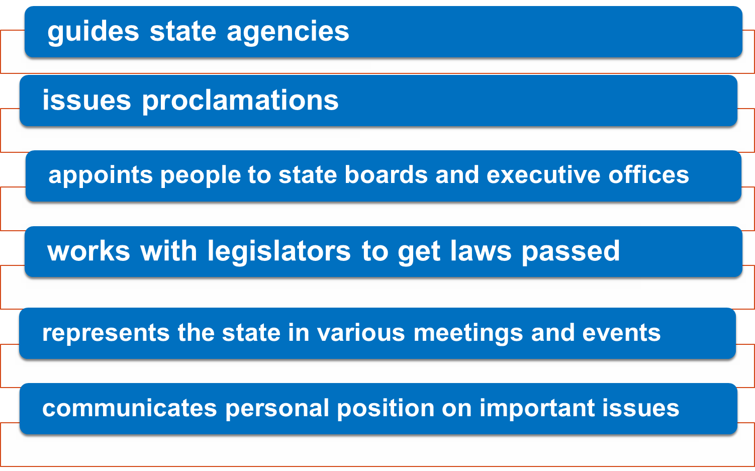
Informal Powers of the Governor
Informal Powers of the Governor
Notes:
‹#›

Slide 21
Who Is Our Current Governor?
Notes:
‹#›

Slide 22
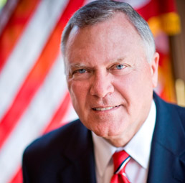
Honorable Nathan Deal
Governor of State of Georgia
Notes:
‹#›

Slide 23
The Lieutenant Governor
Notes:
‹#›

Slide 24
Terms
Elected by a majority of the popular vote
Can serve unlimited number of consecutive terms
Notes:
‹#›

Slide 25
Qualifications
SAME AS GOVERNOR
Must be at least 30 years of age
Must be a citizen of the US for at least 15 years
Must be a resident of the state for at least 6 years
If Governor dies or resigns, the Lieutenant Governor takes over until the next general election.
Lieutenant Governor also serves as the chief executive officer when the Governor is out of state.
Notes:
‹#›

Slide 26
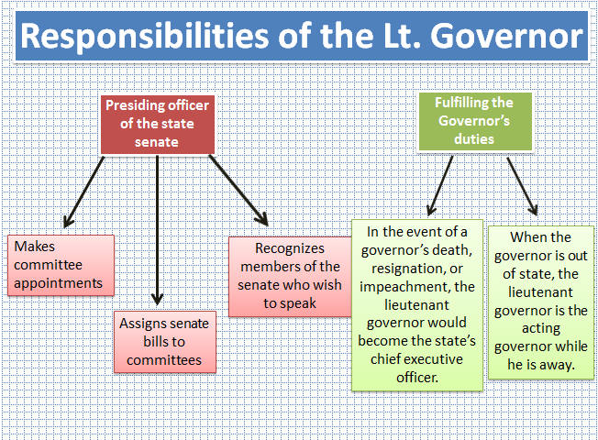
Powers of the Lieutenant Governor
□ Presiding officer of the State Senate
□ Makes senate committee appointments
□ Assigns senate bills to committees
□ Recognizhttp://www.gpb.org/georgiastories/stories/saga_of_reconstructiones members of the senate who wish to speak
□ May affect the passage or failure of some senate bills
Notes:
‹#›

Slide 27
Who Is Our Current Lieutenant Governor?
Notes:
‹#›

Slide 28
Casey Cagle
Notes:
‹#›

Slide 29
Georgia’s Elected Officials
Notes:
‹#›

Slide 30
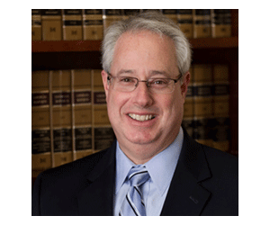
State Attorney General
Chief Legal Officer for the State
Head of the Department of Law
Sam Olens
Notes:
‹#›

Slide 31
Commissioner of Labor
Head of the Labor Department
Regulates the health and safety of workers
Enforces state labor laws
Administers unemployment insurance programs
Maintains statistical data on labor
Mark Butler
Notes:
‹#›

Slide 32
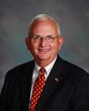
Commissioner of Agriculture
Head of the Agriculture Department
Directs agriculture or agribusiness programs
Maintains state farmers’ markets
Supervises services such as inspections
Expands market opportunities for Georgia agriculture
Gary Black
Notes:
‹#›

Slide 33
Commissioner of Insurance
Regulates insurance carriers
Issues insurance licenses
Ralph Hudgens
Notes:
‹#›

Slide 34
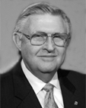
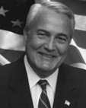
Public Service Commissioners
Regulates utilities in Georgia
Controls the rates and services of transportation companies, telephone companies and electric companies
Chuck Eaton
Tim Echols
Doug Everett
Lauren "Bubba" McDonald, Jr.
Stan Wise

Slide 35
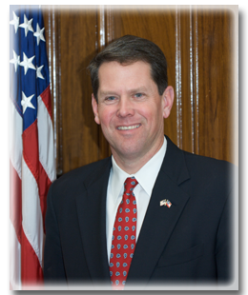
Secretary of State
Maintains the state’s official records
Publishes laws passed by the legislature
Supervises elections
Appoints examining boards
Grants corporate charters
Regulates securities, stocks,
and bonds
Brian Kemp
Notes:
‹#›

Slide 36
State School Superintendent
Head of the Department of Education
Directs statewide educational programs
Enforces state education regulations and laws
Administers state and federal
education funds
Certifies and licenses teachers
and other educators
Approves textbooks for use in
Georgia schools
John Barge

Slide 37
Appointed Officials, Boards, & Commissions

Slide 38
These positions are not provided for in the state’s constitution, nor are they elected, but their jobs are called for by law.
Example: Chief Drug Inspector
Another sector of Georgia’s government are boards and agencies.
There are over 30 major agencies...
Examples:
State Board of Pardons & Paroles
Board of Natural Resources
State Personnel Board
Notes:
‹#›

Slide 39
The Legislative Branch
The Georgia state constitution grants law-making power to the legislative branch.
Georgia’s legislature is officially known as the Georgia General Assembly.
Formed in 1777 as a 1 house legislature.
That makes it older than the Congress of the United States.
In 1789, the Georgia General Assembly was reorganized.
Notes:
‹#›

Slide 40
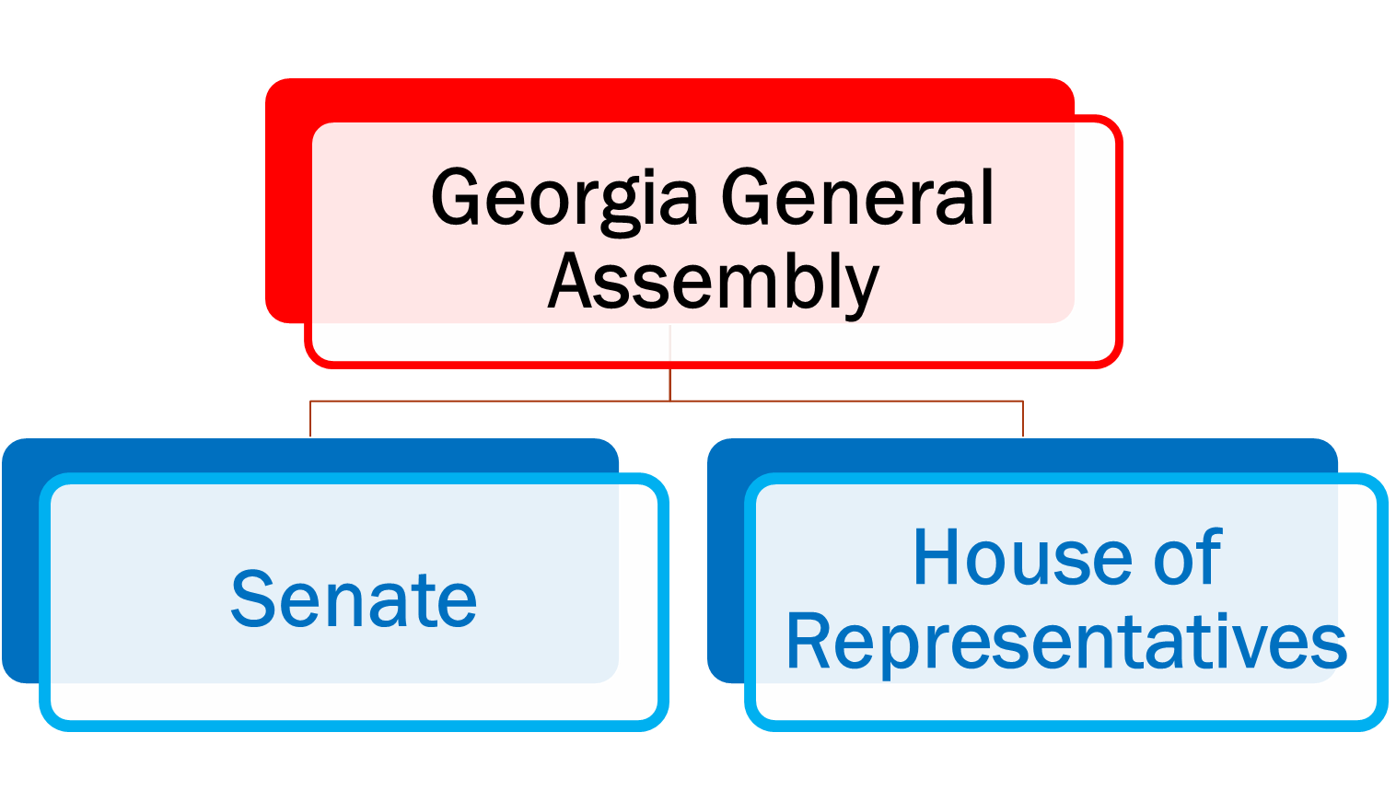
Bicameral (2 Houses)
Notes:
‹#›

Slide 41
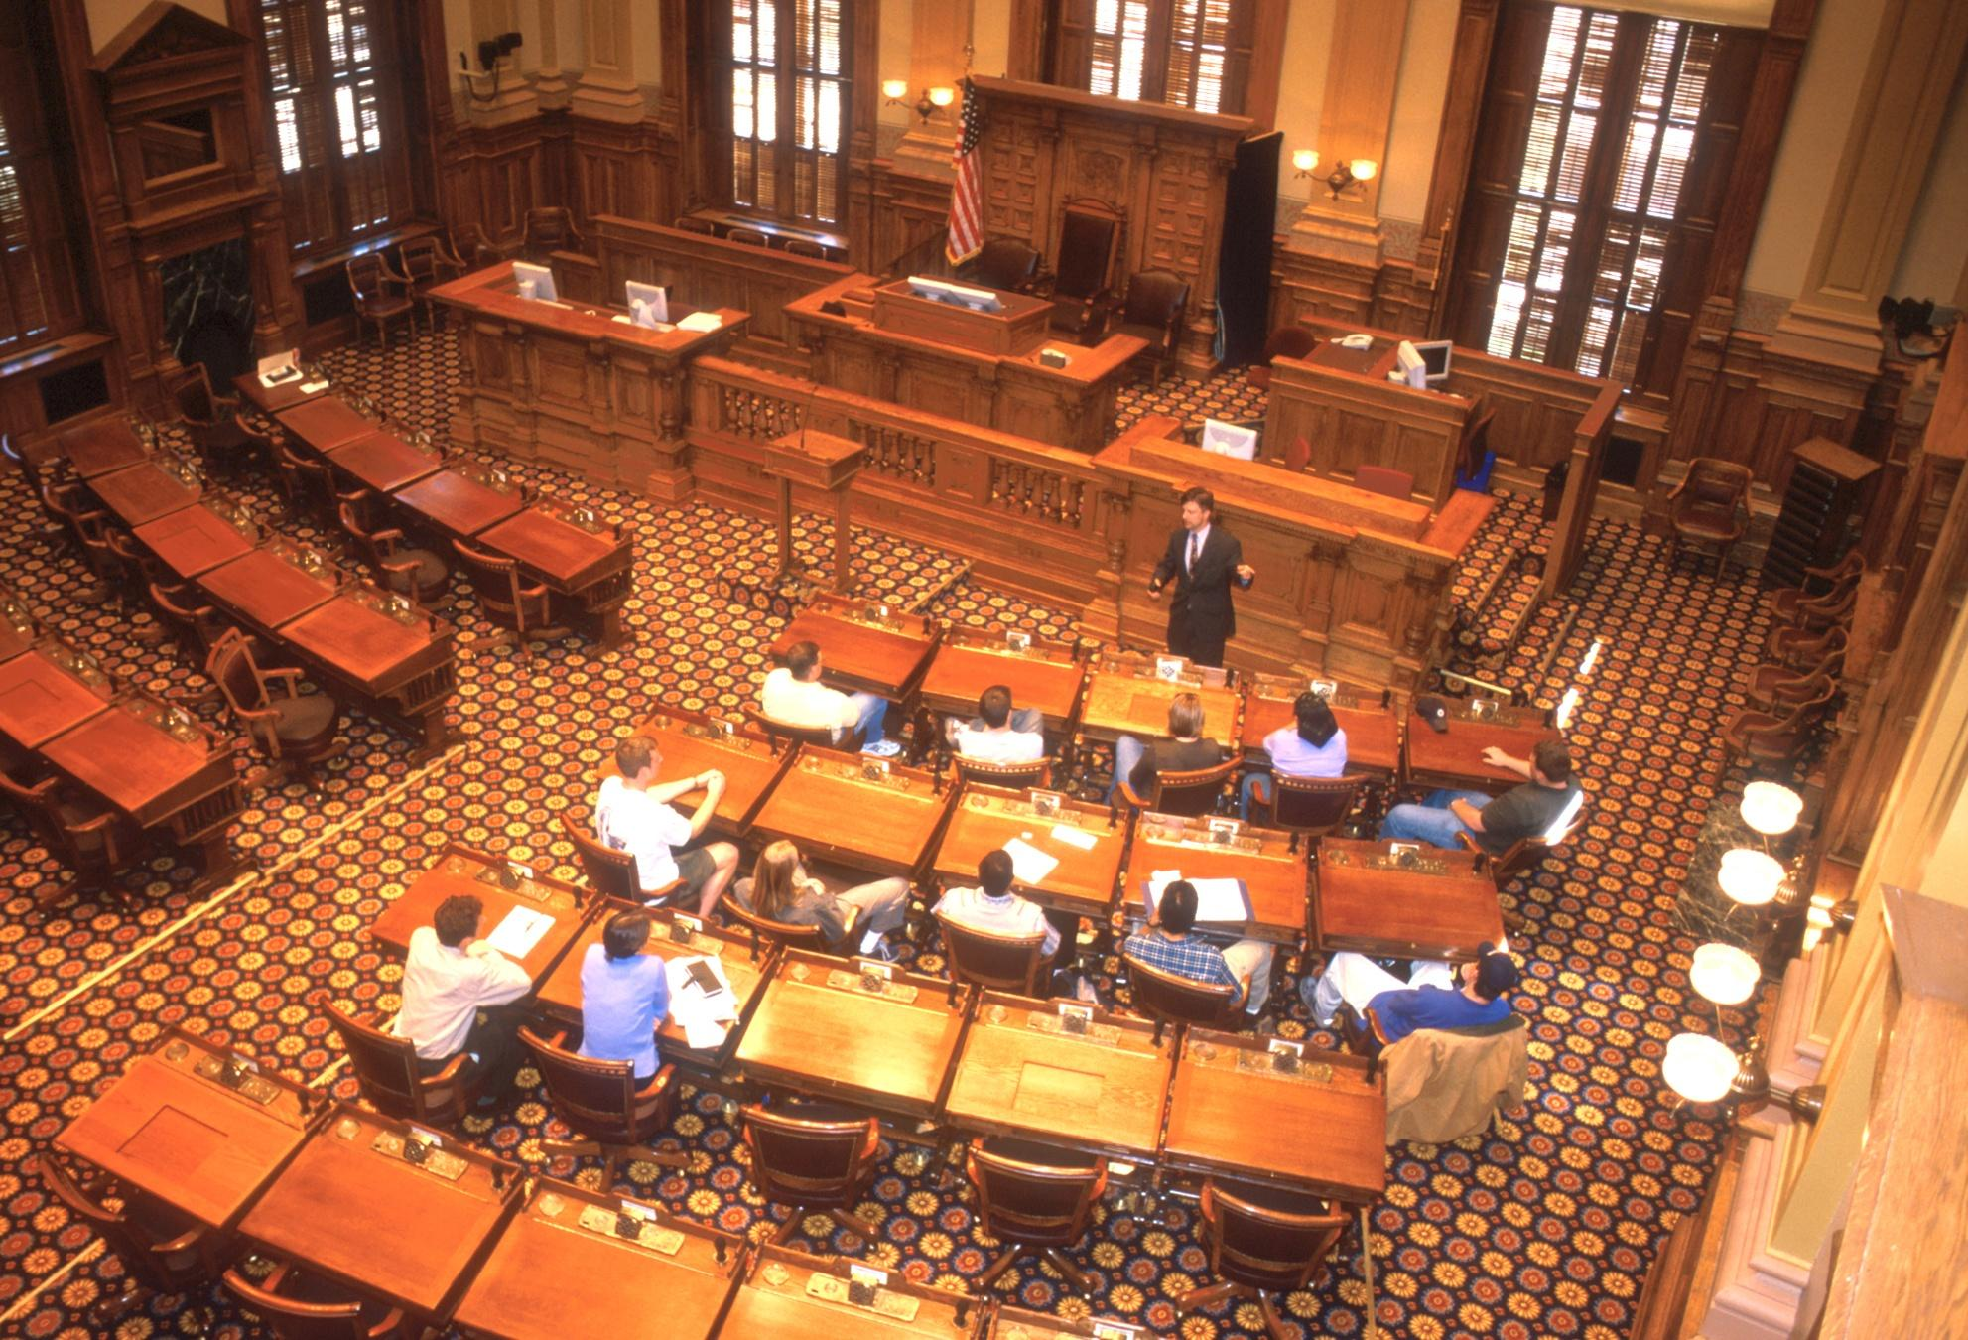
Notes:
‹#›

Slide 42
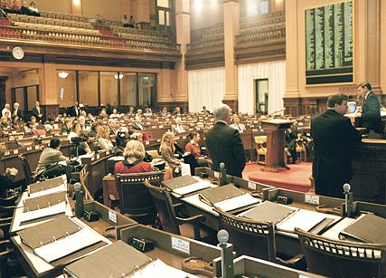
Notes:
‹#›

Slide 43
Senate | House of Representatives
56 Members | 180 Members
At Least 25 Years Old | At Least 21 Years of Age
Citizens of the United States
Citizens of Georgia for at Least 2 Years
Must Have Been Legal Residents of the District from Which They Were Elected for At Least 1 Year
Propose and Pass Bills (All Bills Must Be Approved by Both Houses Before Being Sent to the Governor)
Elected by Popular Vote to 2 year terms
No Limit on Number of Terms
Confirm Appointments the Governor Makes to Executive Offices | Write Appropriations (Spending ) Bills

Slide 44
Legislative Sessions
Meet Yearly
40 Days
Lieutenant Governor Presides Over the Senate
Speaker of the House Presides Over the House of Representatives
During a 40-day session, more than 1,000 bills will be proposed.
Notes:
‹#›

Slide 45
Powers of the Presiding Officer
Determines the order of business
Controls debate
Rule out proposed amendments to bills
Enforces rules of procedure for the General Assembly
Controls meeting times and recesses of the General Assembly
Order a roll call vote on any issue
Notes:
‹#›

Slide 46
Committees
Like Congress, members of the Georgia house and senate are organized into committees.
All bills must be reviewed by a house or senate committee before they can be brought to either the whole house or sent for a vote.

Slide 47
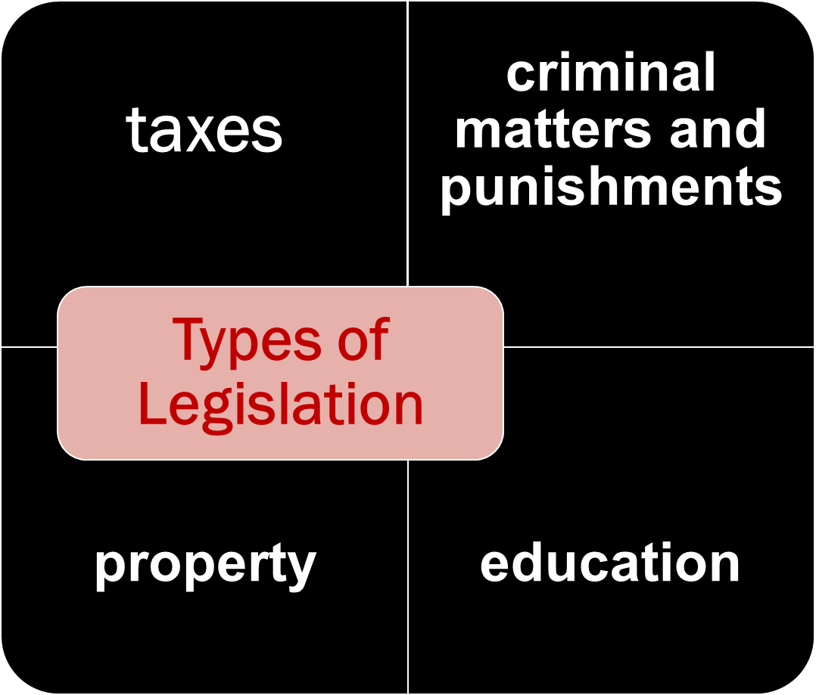
can pass laws, amend (change) them, or do away with them
public health

Slide 48
How does a bill become a Law?
Click on me to see how a
bill becomes a law!

Slide 49
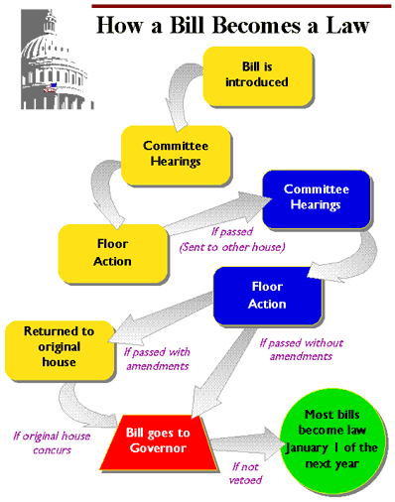
Notes:
‹#›

Slide 50
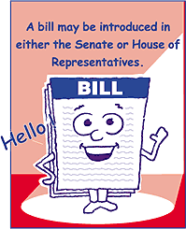
VIDEO

Slide 51
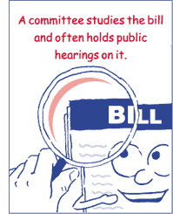
Notes:
‹#›

Slide 52
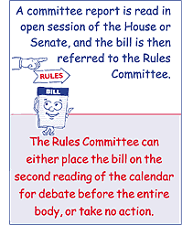
Notes:
‹#›

Slide 53
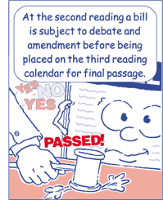
Notes:
‹#›

Slide 54
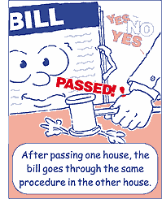
Notes:
‹#›

Slide 55
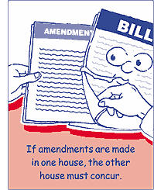
Notes:
‹#›

Slide 56
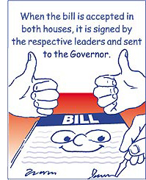
Notes:
‹#›

Slide 57
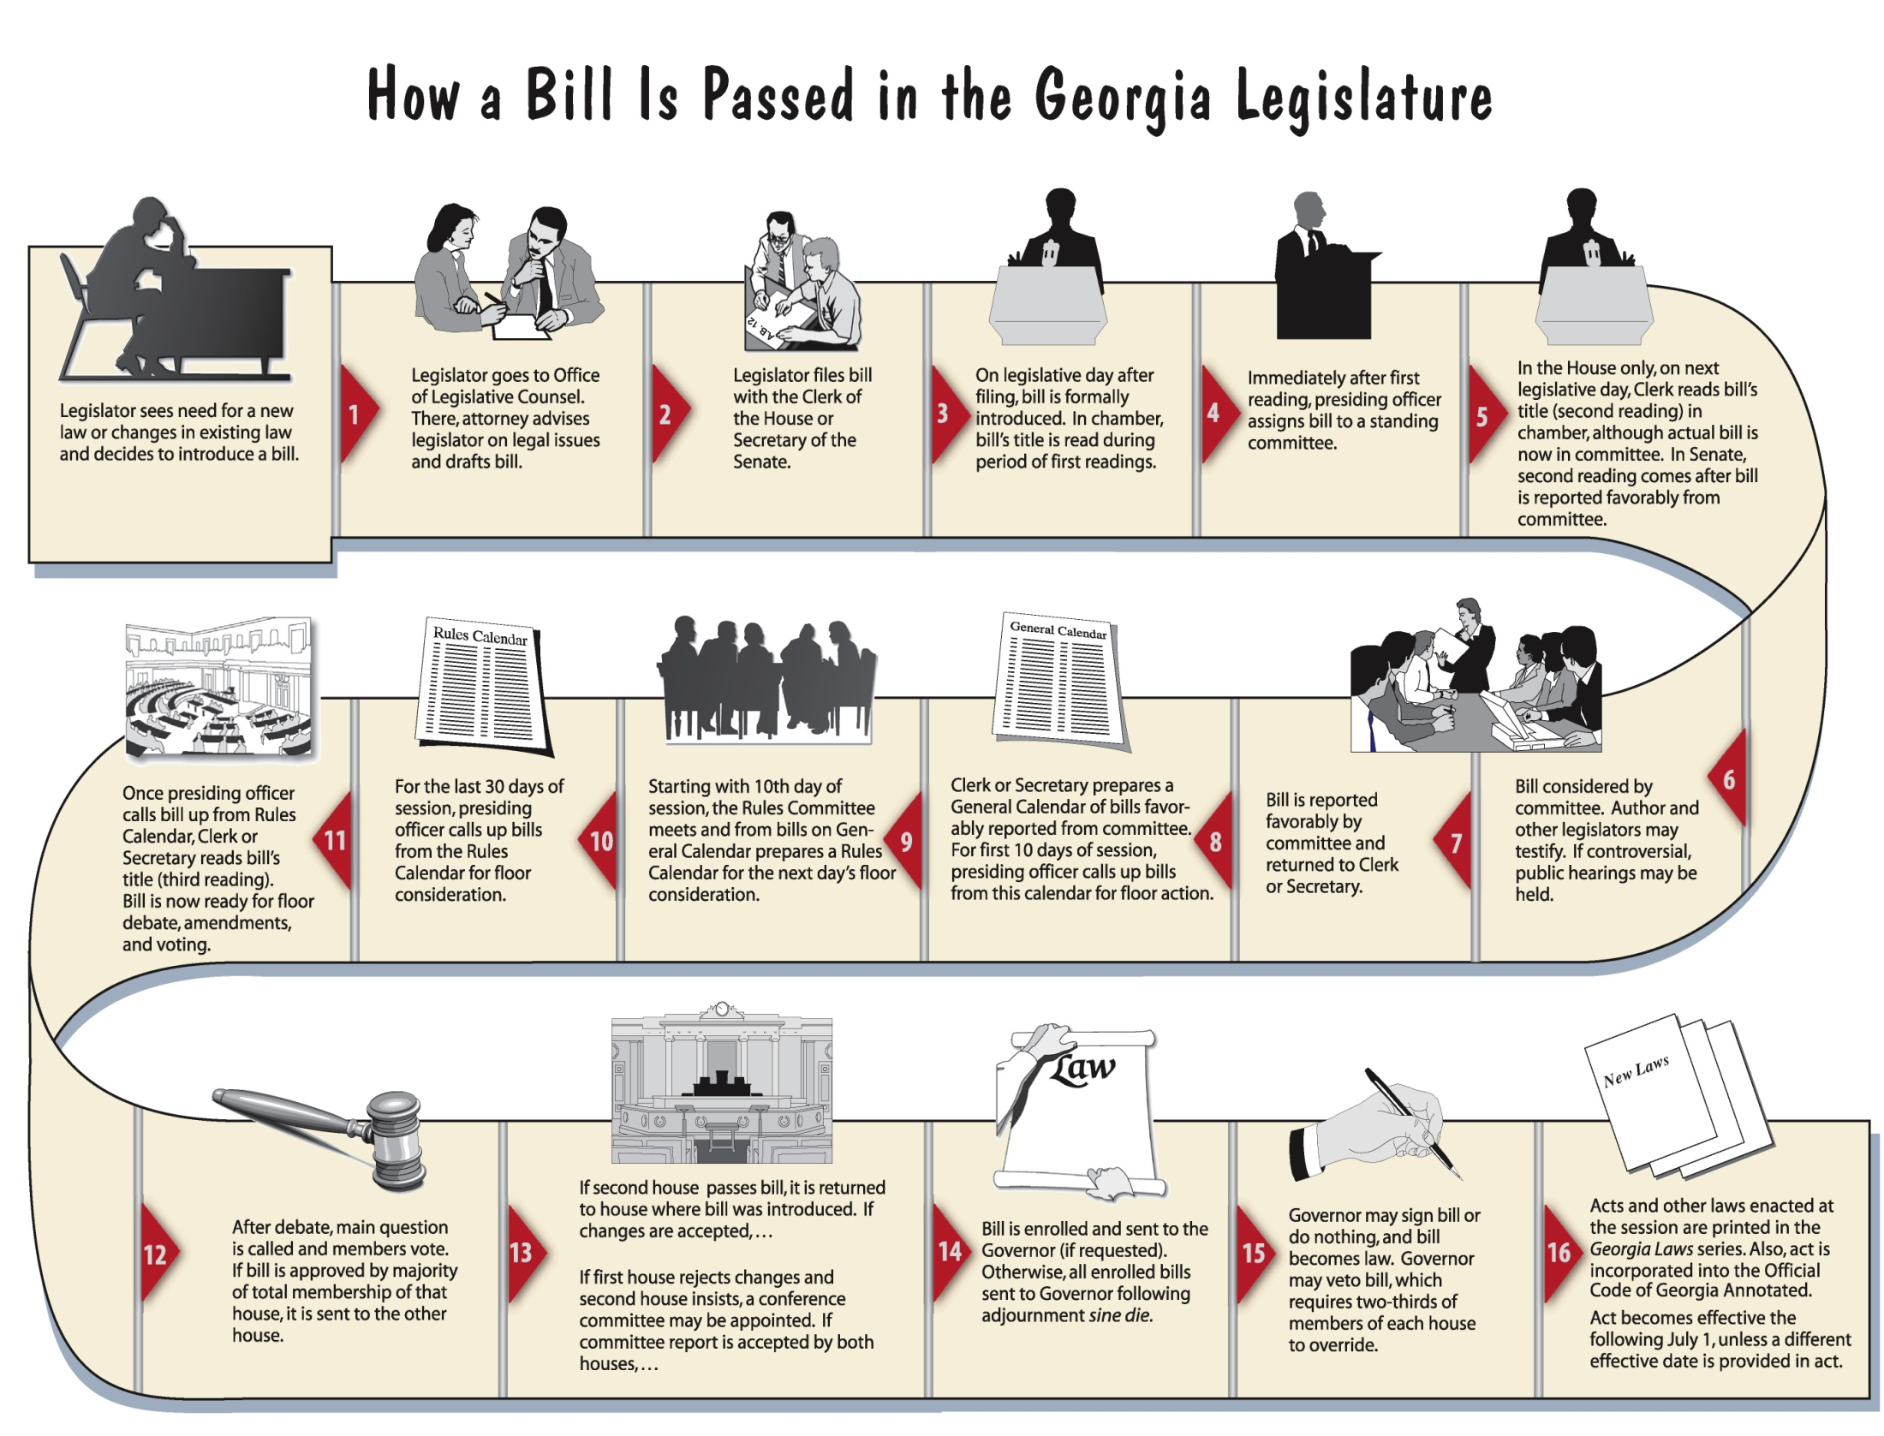
Notes:
‹#›

Slide 58
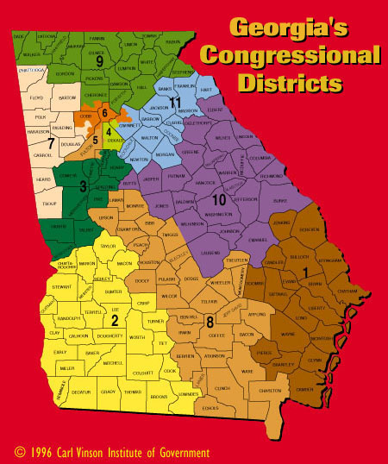
Notes:
‹#›

Slide 59
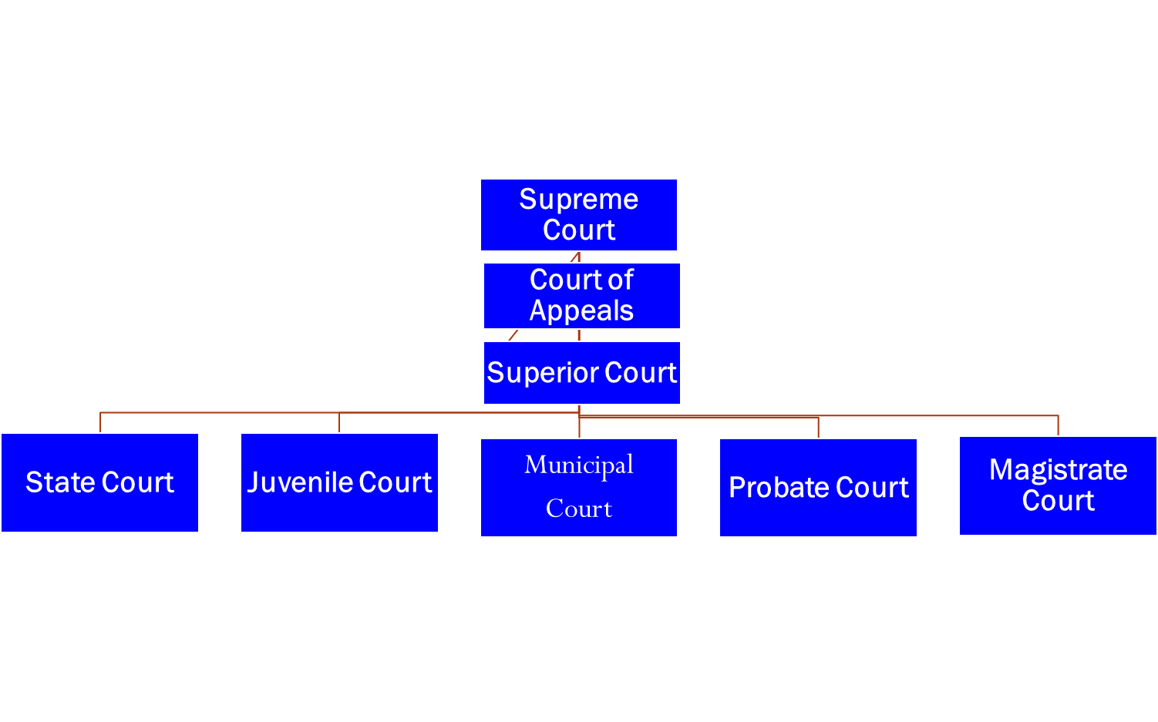
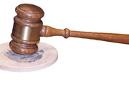
The Judicial Branch
Consists of the state’s courts
7 Judges
12 Judges
159 Courts
Chief Magistrates
354 Magistrates
49 Circuits / 205 Judges
70 Courts
120 Judges
159 Courts
120 Judges
370 Courts
350 Judges
159 Courts
159 Judges
Notes:
‹#›

Slide 60
Duties
Interpret the State Constitution
Protect legal rights of citizens
Enforce laws of the state
Notes:
‹#›

Slide 61
Supreme Court
Reviews decisions made by other courts in civil and criminal cases.
Rules on questions involving the constitutionality of state statutes, all criminal cases involving a sentence of death, and petitions from decisions of the Court of Appeals.

Slide 62
Court of Appeals
First review for many civil and criminal cases decided in the trial courts.
Correct legal errors or errors of law made at the trial level, not to alter jury verdicts or the outcome of bench trials.

Slide 63
Superior Court
Exclusive, constitutional authority over felony cases, divorce, equity and cases regarding title to land.
Corrects errors made by lower courts

Slide 64
State Court
misdemeanor violations, including traffic cases, and all civil actions, regardless of the amount claimed, unless the superior court has exclusive jurisdiction.
Issue search and arrest warrants

Slide 65
Juvenile Court
protect the well-being of children, provide guidance and control conducive to child welfare and the best interests of the state, and secure care for children removed from their homes.

Slide 66
Municipal Court
municipal ordinance violations, issue criminal warrants, conduct preliminary hearings, and may have concurrent jurisdiction over shoplifting cases and cases involving possession of one ounce or less of marijuana.

Slide 67
Probate Court
wills, administration of estates, appointment of guardians and involuntary hospitalization of incapacitated adults and other individuals.
oaths of office and issue marriage licenses.
They may hold habeas corpus hearings or preside over criminal preliminary hearings.

Slide 68
Probate Court Continued
Unless a jury trial is requested, may also hear certain misdemeanors, traffic cases and violations of state game and fish laws
election supervisors and make appointments to certain local public offices.

Slide 69
Magistrate Court
civil claims of $15,000 or less; certain minor criminal offenses; distress warrants and dispossessory writs; county ordinance violations; deposit account fraud (bad checks); preliminary hearings; and summonses, arrest and search warrants.

Slide 70
Magistrate Court Continued
May grant bail in cases where the setting of bail is not exclusively reserved to a judge of another court.
No jury trials are held in magistrate court. If a defendant submits a written request for a jury trial, cases may be removed to superior or state court.

Slide 71
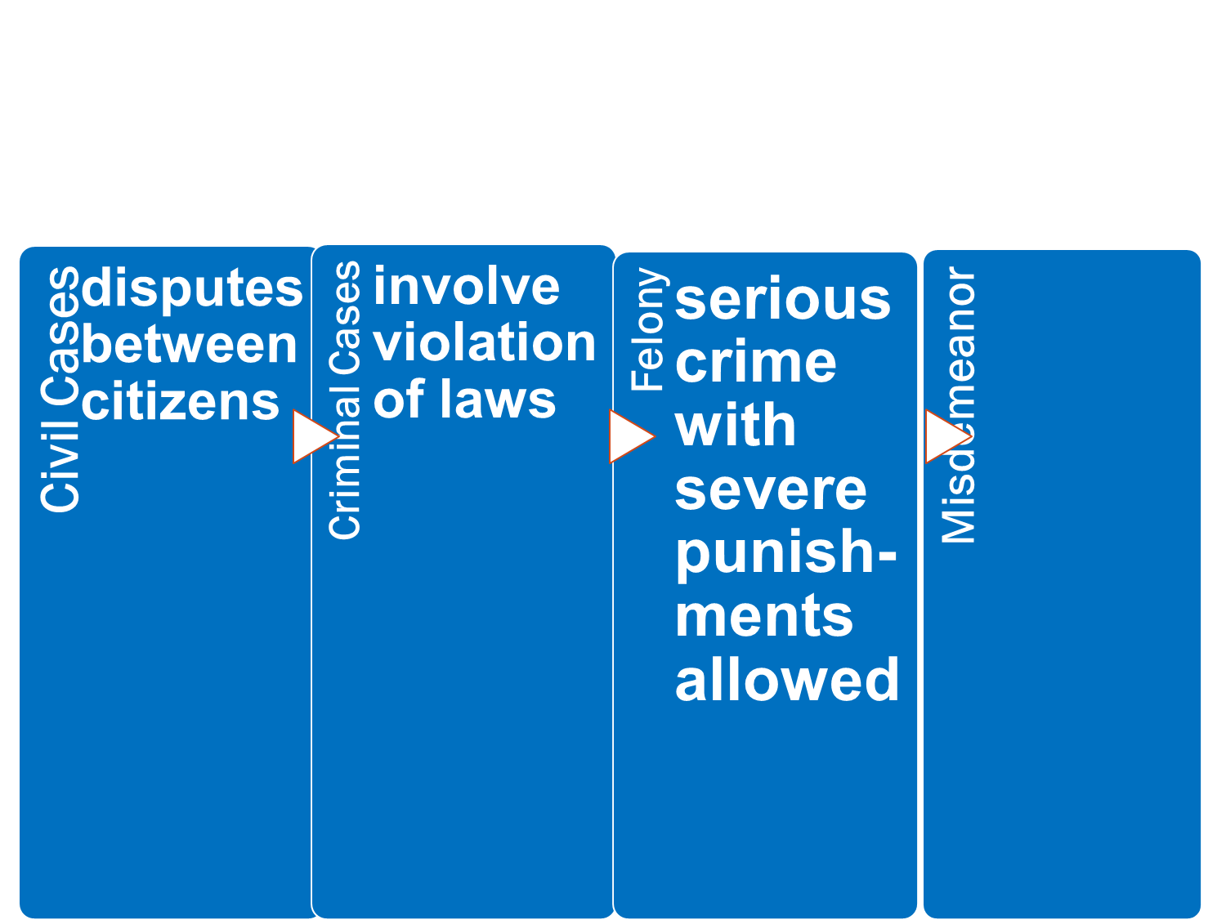
Types of Court Cases
less serious crime with smaller punish-ments
Notes:
‹#›

Slide 72
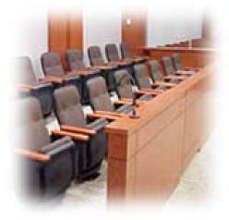
The Jury System
□ Trial before one’s peers
□ Two Types:
1) Grand Jury -- determines whether or not persons accused of crimes should be indicted (officially charged) and required to stand trial.
2) Trial Jury -- group of citizens who are charged with judging a person charged with a crime
Notes:
‹#›

Slide 73
Young People and the Law
Over 2,500 children in jail in Georgia
juvenile: citizen under the age of 17
truancy: failure to attend school
juveniles must follow state’s laws, but violators may be tried by a juvenile court
Common Crimes: smoking, drinking alcohol, loitering (hanging around a public place without permission), violating curfews, running away
Notes:
‹#›

Slide 74
Juvenile Court System
every county has a juvenile court
purposes:
help and protect children
ensure protection of children coming under their jurisdiction
provide care for children removed from their home
delinquent behavior: act that would be a crime if committed by an adult (example: burglary, etc..)
unruly behavior: act that would not be a crime if committed by an adult (example: smoking, drinking, etc…)
Notes:
‹#›

Slide 75
Steps in Juvenile Justice Process
juvenile “taken into custody”
intake: intake officer evaluates case
detain or release (to parents)
detained juveniles sent to RYDC (regional youth detention center)
probable cause hearing before a juvenile court judge
dismissal, informal adjustment, or formal hearing
if the juvenile committed a serious offense or multiple offenses, a judge has many sentencing options
Notes:
‹#›

Slide 76
Georgia’s Seven Deadly Sins Act
1994: legislature addressed issue of increasingly violent youth crime
juveniles charged with certain crimes (murder, rape, armed robbery with a firearm) could be treated as adults by the courts
superior courts handle these cases
mandatory 10-year sentences were a part of the new law
Notes:
‹#›

Slide 77
Rights of Juveniles
juveniles have the right to a fair and speedy trial
no juries in juvenile cases
parents or guardians may be present at hearings
attorney must be provided if child’s parents cannot afford one
Notes:
‹#›

Slide 78
Students’ Rights Under School Law
sometimes students’ rights have been in conflict with schools’ authority
courts have ruled that students’ civil rights are in effect at school; however, schools have been given broad power to control and manage the school environment
Notes:
‹#›

Slide 79
Students’ Responsibilities Under School Law
students have a legal right to a free public education
responsibilities of students:
attend school regularly from ages 6-16
follow reasonable rules and regulations
work with school officials to prevent disruption and violence which keeps students from learning and achieving
Notes:
‹#›

Slide 80
How Is Georgia’s Government Funded?
Notes:
‹#›

Slide 81
Notes:
‹#›

