Slide 1
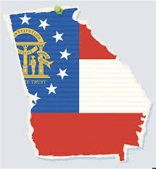
Georgia’s Geography
Describe Georgia with regard to physical features and location. SS8G1

Slide 2
Where are we?
Take a moment and make a list of ways you can describe Georgia’s location locally, nationally, and globally.
Notes:
List on the board student responses.

Slide 3
Georgia’s location
Southeast region of America.
Northern and Western Hemisphere
Latitude 30 ° 31’ and 35° N
Longitude – 81° W to 85 ° 53’ W
Notes:
Instruct students to write this in their notes.

Slide 4
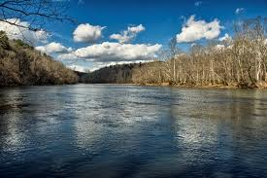
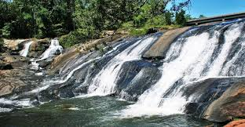
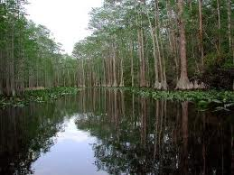
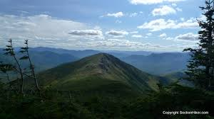
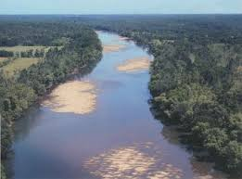
Cool physical features in Georgia!

Slide 5
Physical Feature - Fall Line
The Fall Line stretches across middle Georgia.
Divides the Piedmont from the Coastal Plain Regions.
It is a Change/Drop of elevation and Landscape
from hills to flat plains.
Creating short flowing waterfalls and rivers, used
by early settlers of Georgia for mills/power.
Cities: Columbus, Macon, Milledgeville, and Augusta.

Slide 6
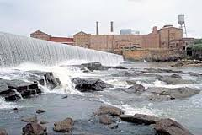
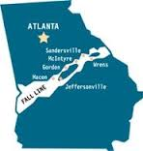
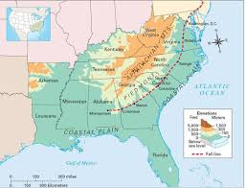
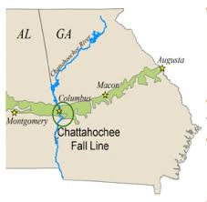
Fall Line

Slide 7
Physical Feature - Okefenokee Swamp
The Largest freshwater swamp in the N.A.
Name means “land of trembling earth.”
Home to more than 1,OOO types of plants and animals.
What region is Swamp located?

Slide 8
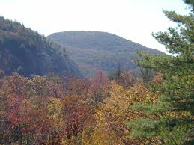
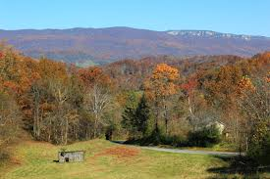
Physical Feature - Appalachian Mountains
Southern most point is inBlue Ridge region.
Trail begins in Georgia and ends in Maine.
Covers all 3 North GA. regions and N.E. Alabama.

Slide 9
Physical Feature - Chattahoochee River
Begins in Blue Ridge Region and forms border between GA and AL.
Was used for transportation and trade with Natives and early colonist/settlers.
Provides hydroelectric power.
Forms Lake Lanier and
Great Recreation Industry.

Slide 10
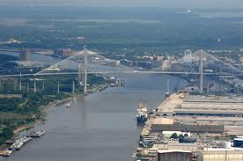
Physical Features - Savannah River
Forms border between GA and SC.
River begins at Lake Hartwell and flows south to Savannah emptying into the Atlantic Ocean.
Trade & Transportation was very important to early settlers & colony of Georgia.

Slide 11
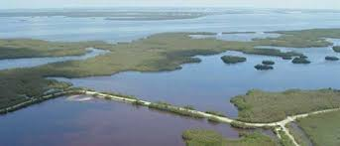
Physical Features - Barrier Islands
Early home to the Spanish & English.
Today a popular tourist destination.
Protects Mainland: Weather, erosion, and Invasions.
Islands: Sapelo, Tybee, Jekyll, St. Simon, St. Catherines, Cumberland, more.

Slide 12
7 Natural Wonders of Georgia

Slide 13
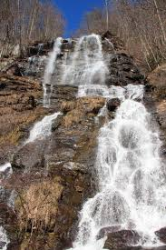
Amicalola Falls
Video
Highest waterfall east of the Mississippi.
729 feet tall
Name means tumbling water.

Slide 14
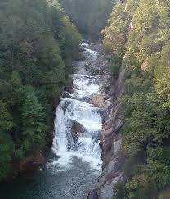
Tallulah Gorge
Video
Deep gorge carved into rock with a series of
waterfalls.
Popular tourist attraction
Sacred to the Native
Americans.

Slide 15
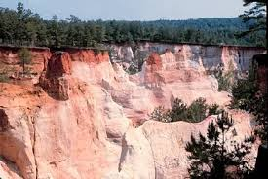
Providence Canyon
Video
Man made in the past 150 years due to erosion and poor farming techniques.
Called Georgia’s “Little Grand Canyon”

Slide 16
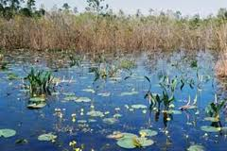
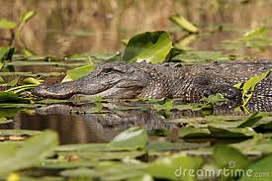
Okefenokee Swamp
Video
Notes already taken : )

Slide 17
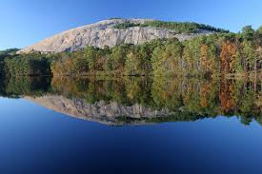
Stone Mountain
Video
650 feet tall and 2 miles long.
Largest Confederate Memorial.
Made of granite.

Slide 18
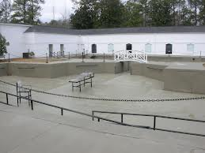
Warm Springs
Video
Warm, mineral water was known as healing water.
Made famous by Franklin D. Roosevelt.
Water stays a constant 88 degrees.

Slide 19
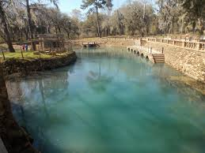
Radium Springs
Video
Constant 68 degrees
70,000 gallons a water a minute gush from this spring.
Traces of radium
Sacred to Native Americans.

Slide 20
5 Geographic Regions of Georgia:
Appalachian Plateau
Ridge and Valley
Blue Ridge
Piedmont
Coastal Plains
“A Really Blueish Purple Cat”

Slide 21
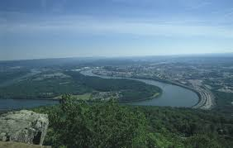
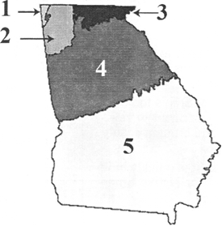
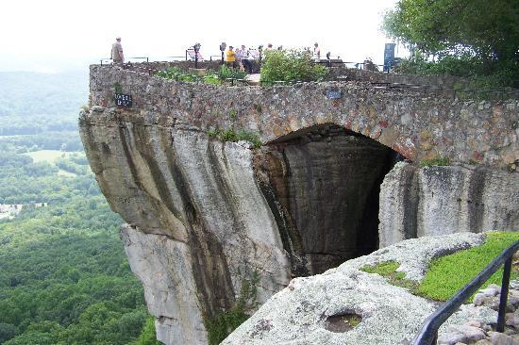
1. Geographic Regions – Appalachian Plateau
Smallest region in Georgia.
Located in northwest corner.
Region is made up of narrow valleys and wooded ridges.

Slide 22
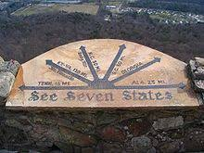
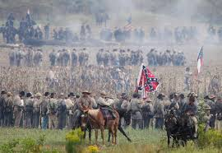
Appalachian Plateau
-Lies in the TAG corner (Tennessee, Alabama, and Georgia).
-Home to Lookout Mountain, Rock City, Cloudland Canyon, and Chickamauga (Civil War) Battlefield.
-Deep canyons and BIG Rock Formations.
-Narrow valleys with pastures and limestone ridges.

Slide 23
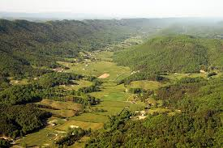
2. Geographic Region – Valley and Ridge
This area consists of several mountain ridges and valleys created between them.
Mining and farming are the main industries in this region.

Slide 24
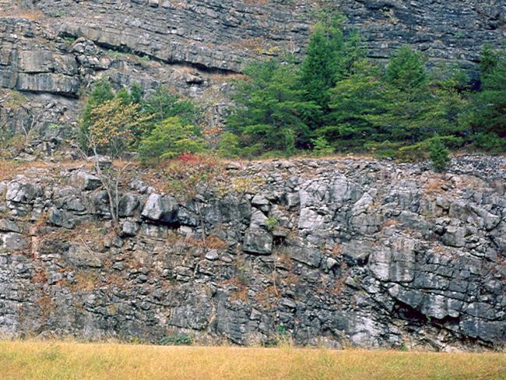
Ridge & Valley
-Wedged between Blue Ridge to the East and Appalachian Plateau to the West.
-Open valleys with fertile farmland pastures for livestock and apple orchards.
-Big Textile and Carpet Industry.
-Granite and Marble Industry out of the Mountain Ridges.

Slide 25
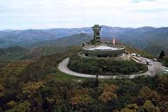
3. Geographic Region – Blue Ridge Mountains
Southernmost point of the Appalachian Mountains.
Brasstown Bald (highest point in GA) is located in this region.
First US gold rush took place here in 1828.

Slide 26
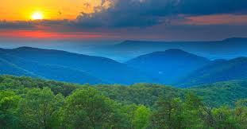
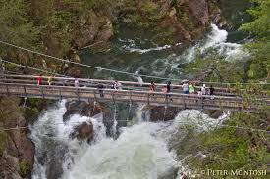
Blue Ridge Mountains
Northeast corner of Georgia.
Warm air from the Gulf of Mexico meets in cool Mountains creating greatest precipitation of all regions to the entire state.
Chattahoochee River originates in this region and other streams/rivers.
Tourist industry in this region.
Helen, Dahlonega, Amicalola Falls, Tallulah Gorge...some popular attractions.

Slide 27
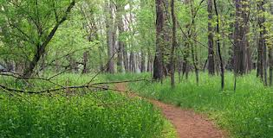
4. Geographic Region - Piedmont
Most populated region.
Used to be home to many cotton plantations but today industry leads the economy.
Buford is in this region!

Slide 28
Piedmont
-”Foot of the Mountain” with rolling hills.
- South of region meets “Fall Line” and the Coastal Plain Region.
- Home to BIG Population of Metro-Atlanta (metropolitan).
- Home to JOBS...known as Heartland of the Sate.
- Red Clay and Granite.
- Today- wheat, soybeans, corn, poultry and cattle raised in this region.

Slide 29
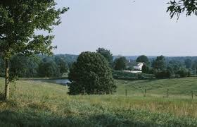
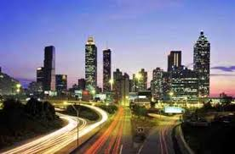
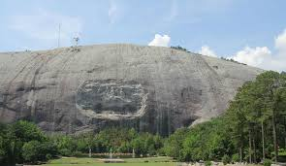
Piedmont Pics

Slide 30
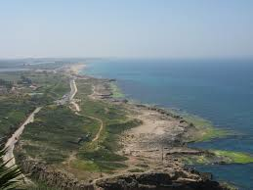
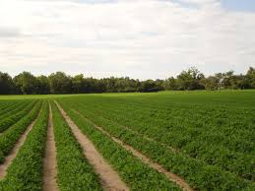
5. Geographic Region – Coastal Plain
Peanut, cotton, and vegetable farming takes place in this region.
Largest region in Georgia.

Slide 31
Coastal Plains
Inner: Known for BIG Agriculture/Farming.
Some of the 5 Ps grown here. Along with Vidalia Onions, Watermelons, Corn.
Outer: Poor soil for farming.
Industries: Tourist, seafood, Pine trees (paper mills) and Ports (ships & trade).
Savannah, Brunswick, and Darien are Big Cities in this region.
Okefenokee Swamp BIG attraction in region.
Barrier Islands/Beaches on the coast of the region.

Slide 32
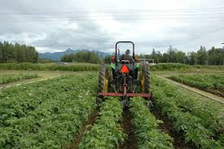
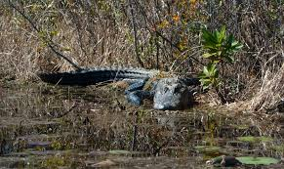
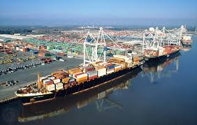
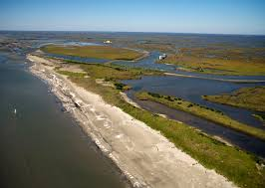
Inner and Outer Coastal Plains

