Slide 1
HOW A BILL BECOMES A LAW IN GEORGIA
SS8CG2: The student will TRACE the steps in the legislative process for a bill to become a law in Georgia

Slide 2
Definition of a bill
A text that calls for a change or an addition to the law.
Examples of bills
Amendment of existing law
Revenue (tax) legislation
Bills signed into law by Governor Perdue

Slide 3
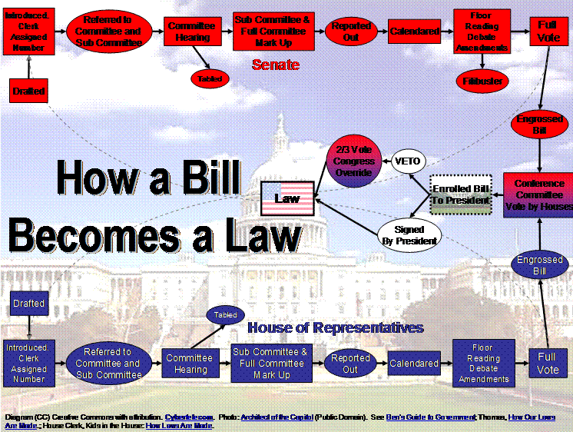
Complex U.S version

Slide 4
Simple version in 5 steps

Slide 5
Step 1: Drafting
With the help of lawyers from the Office of Legislative Counsel, legislators write the text of the bill.

Slide 6
Step 2: Introduction
Only senators or representatives are allowed to introduce bills. They submit it to their house (Senate or Representatives)
In the House of Representatives—Submitted to the Clerk of the House who makes copies of it, reads it aloud to the House.
In the Senate—The Secretary of the Senate does the same thing

Slide 7
Step 3: Committee Consideration
Bill is assigned to a committee depending on its subject.
The bill is studied by the committee
The committee invites people to comment on the bill (other legislators, state officials, the public, the bill’s author, or lobbyist)
Decision:
Committee decides the bill should not go forward it gets a stamp, “DO NOT PASS” report
Do nothing, which kills the bill
Committee decides the bill should go forward it gets a stamp, “DO PASS”
“DO PASS with AMENDMENTS”
“DO PASS with SUBSTITUTE”

Slide 8
Step 4: Floor Consideration
After the bill has passed through committee it is:
Read aloud in either the House of Representatives or the Senate during the regular session (January-April)
A vote is called
Majority of representatives (91 out of 180) approves then it goes to Senate
Senate must approve by majority (29 out of 56)
Legislators debate the bill and make changes to it (in either house)
Both houses have to approve IDENTICAL copies of the bill for it go move on…

Slide 9
Step 5: Governor Consideration
Sent to the governor
Governor’s options:
Sign the bill into law
Veto the bill (sending it back to the General Assembly)
Do nothing (the bill automatically becomes law after 40 days)

Slide 10
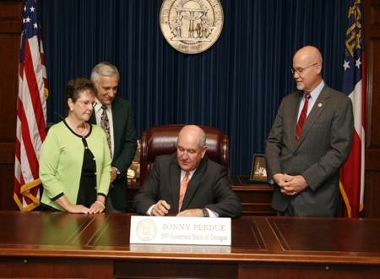

Slide 11
Exit ticket
Create a chart using illustrations of how a bill becomes a law in Georgia

